Slide 1
ENSC 427: Communication Networks
Spring 2023
Final Project Presentation
ANALYSIS OF CLOUD SECURITY USING TLS/HTTP/TCTP
www.sfu.ca/~alons/ProjectHomepage.html
WRITTEN BY GROUP 3
ALON SINGH 301381523 alons@sfu.ca
RIKU MAKITA 301381399 rmakita@sfu.ca
By Your Name

Slide 2
Roadmap
Introduction
Overview
Simulation
Results
Future Direction

Slide 3

Introduction
Cloud Security: A shared responsibility model
Why is Cloud Security important?
Industry Leaders:
Cloudflare
Crowdstrike
VMware
Types:
Encryption
Identity Access Management
Firewall
Security monitoring

Slide 4
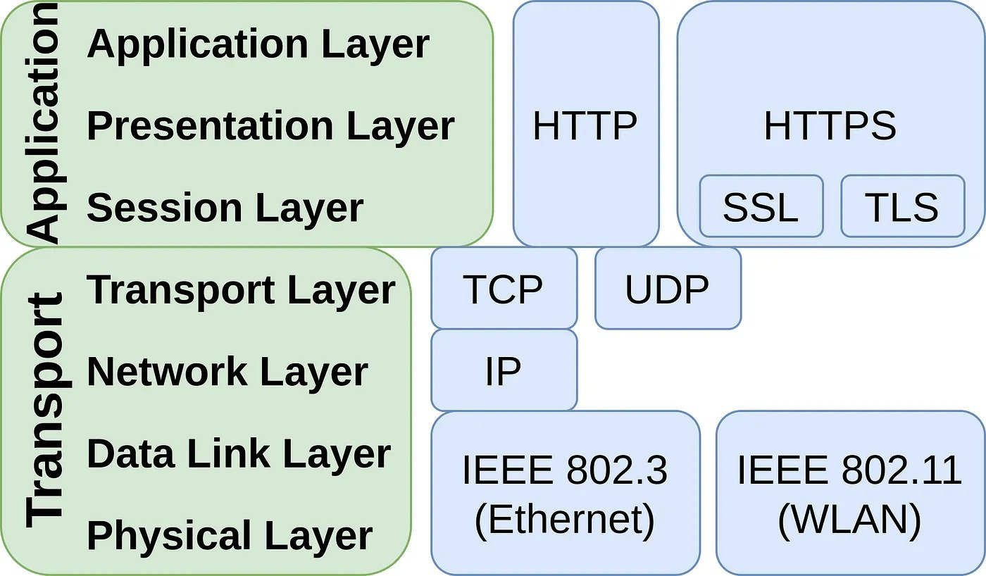
Overview
Encryption methods:
Secure Socket Layer (SSL)
Explicit connection
Transport Layer Security (TLS)
Implicit connection
Encryption: Purposeful scrambling of data
[10] Thomas, M. (2021, January 17). HTTPS vs SSL vs TLS. Medium.

Slide 5
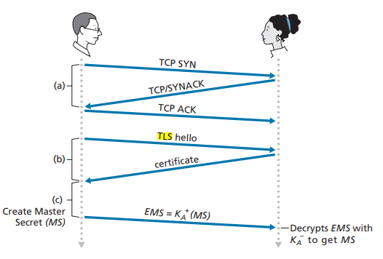
Transport Layer Security (TLS)
Advantages
Encryption, authentication, integrity
Improves security
Instills trust
Easily deployed
Drawbacks
Dependence on intermediaries
Legal obligations
Can’t be used with HTTP
[11] J. F. Kurose and K. W. Ross, Computer networking: A top-down approach.

Slide 6
The Experiment

Slide 7
Simulation - The Good
<!-- Created November 2014 chris@anthum.com www.anthum.com --> <html> <head> <script src="https://www.httpvshttps.com/check-server.js"></script> <script> function log(o) {if (console) console.log(o);} var proto = window.location.protocol; proto = proto.substring(0,proto.length-1); function setActiveMenu() { if ('http' == proto) { document.getElementById('menu-http').className += ' active'; } else if ('https' == proto) { document.getElementById('menu-https').className += ' active'; } } </script> <script> …
Using the website “HTTP vs HTTPS” we can download 360 new non-cached through both HTTP and HTTPS.
Combined with wireshark to capture the data packets, and the command below to retrieve them, we can compare the different protocols.
PCAP files were saved from and graphed as well
curl http://www.httpvshttps.com
Command to retrieve data from the link.
Portion of output from the command.

Slide 8

Simulation - The Bad
Simulations in ns3 by default only use HTTP.
There will not be a uniform way to compare these results to any TLS encrypted data.
Encryption algorithms can be implemented in ns3, but do not interface well with a network simulation.

Slide 9
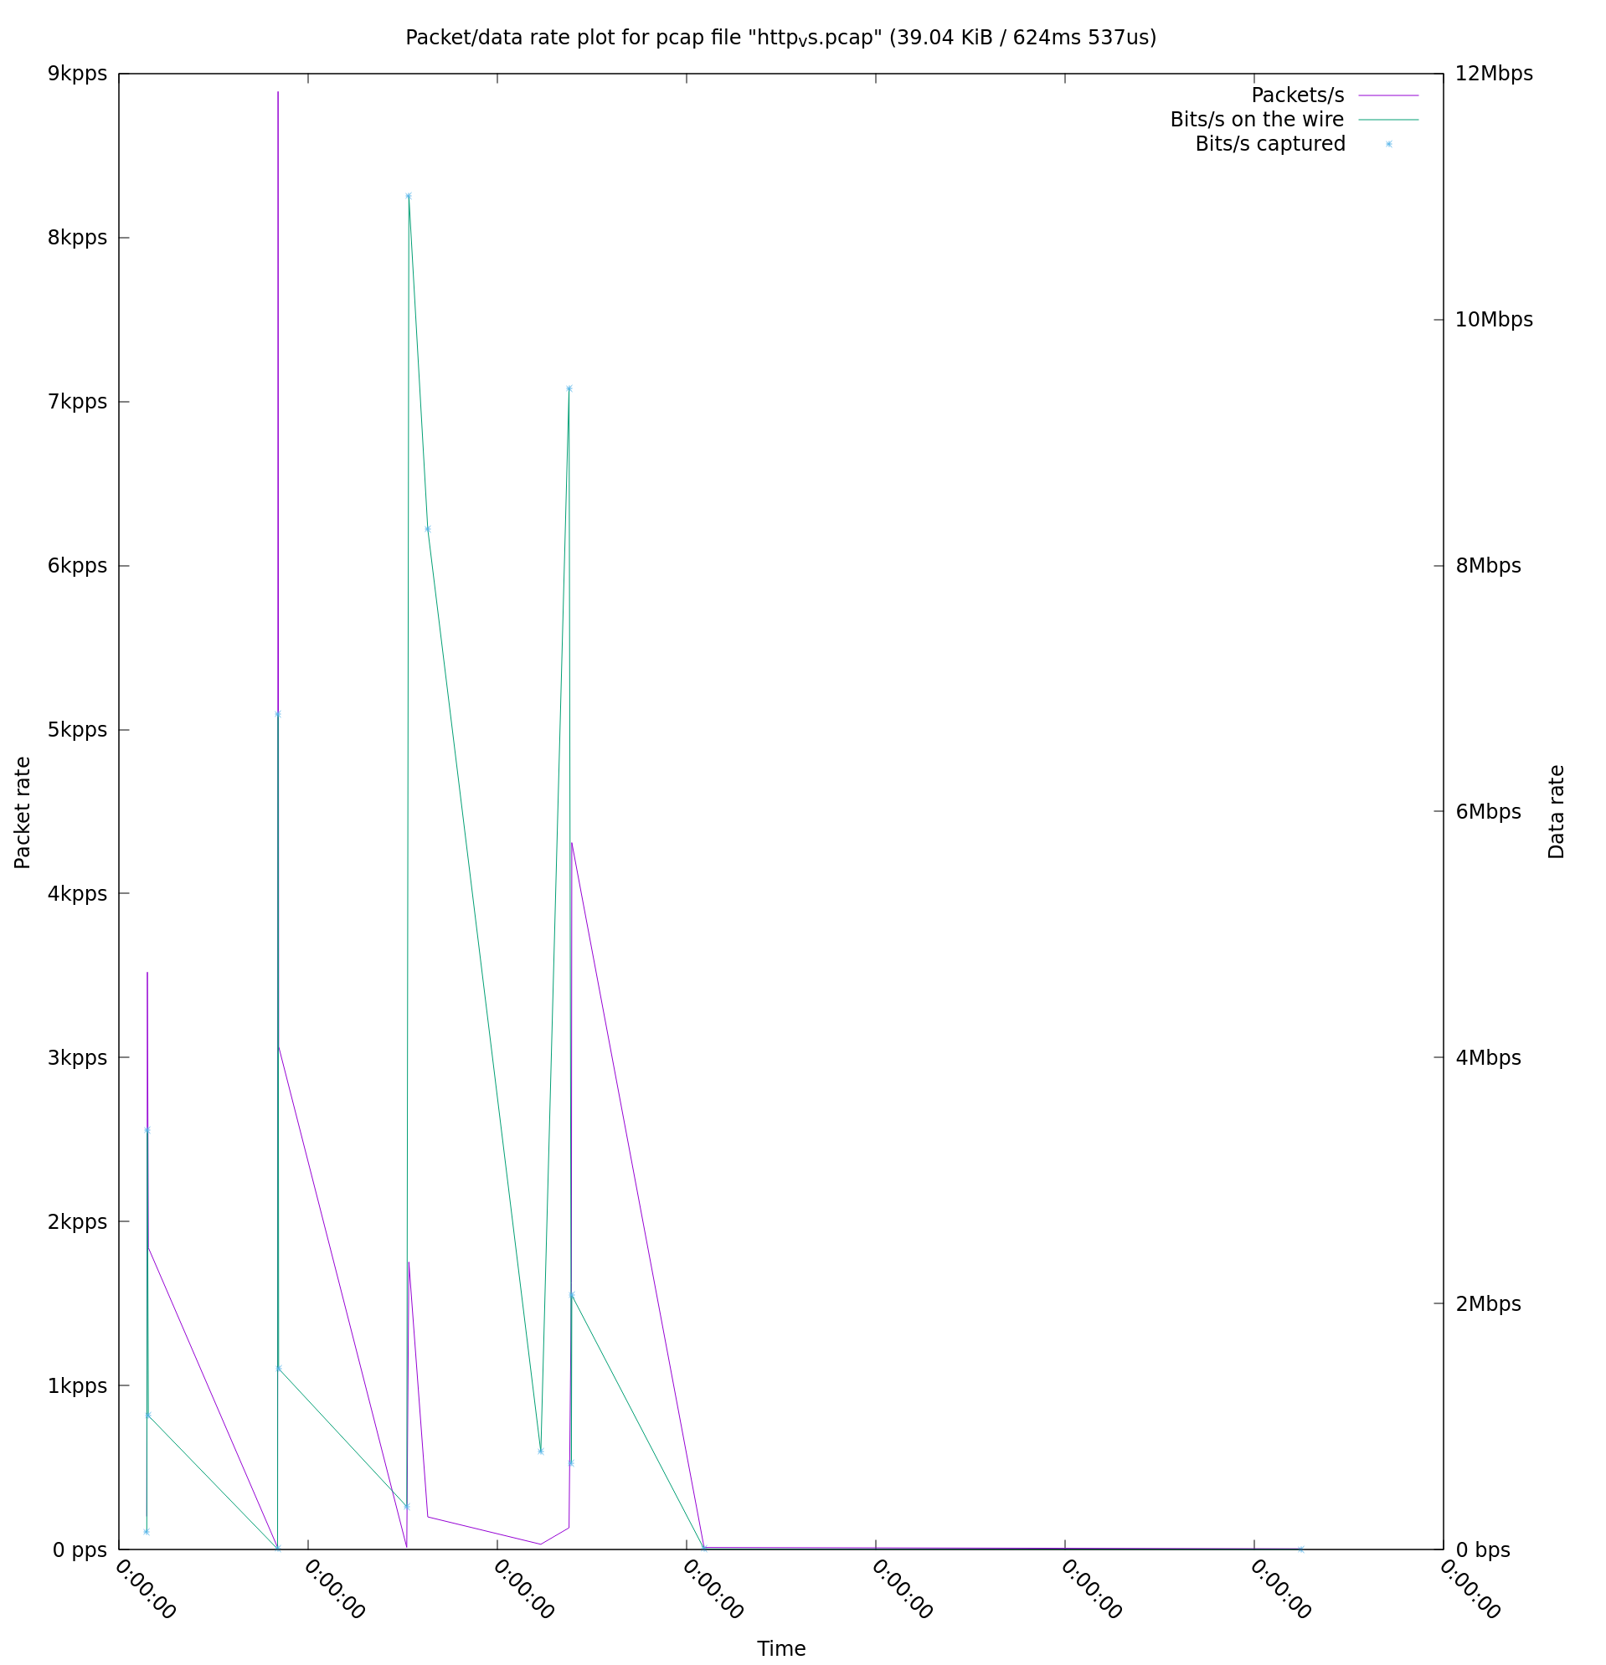
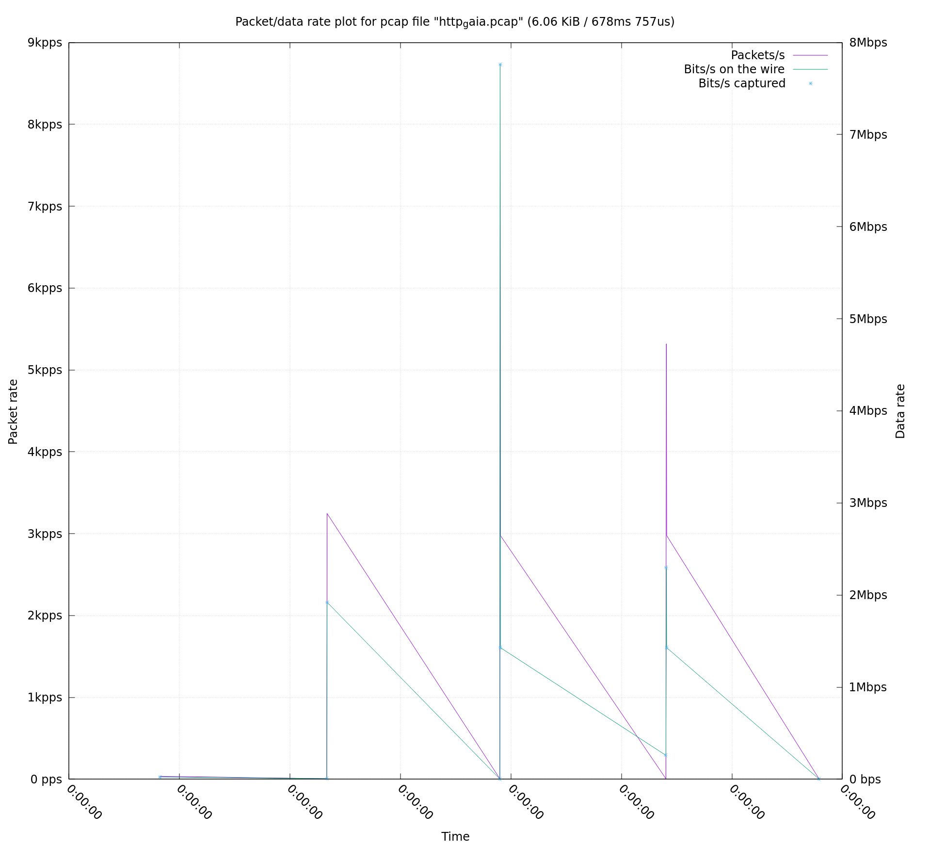
Simulation - The Results - HTTP
http://www.httpvshttps.com
http://gaia.cs.umass.edu/wireshark-labs/HTTP-wireshark-file3.html

Slide 10
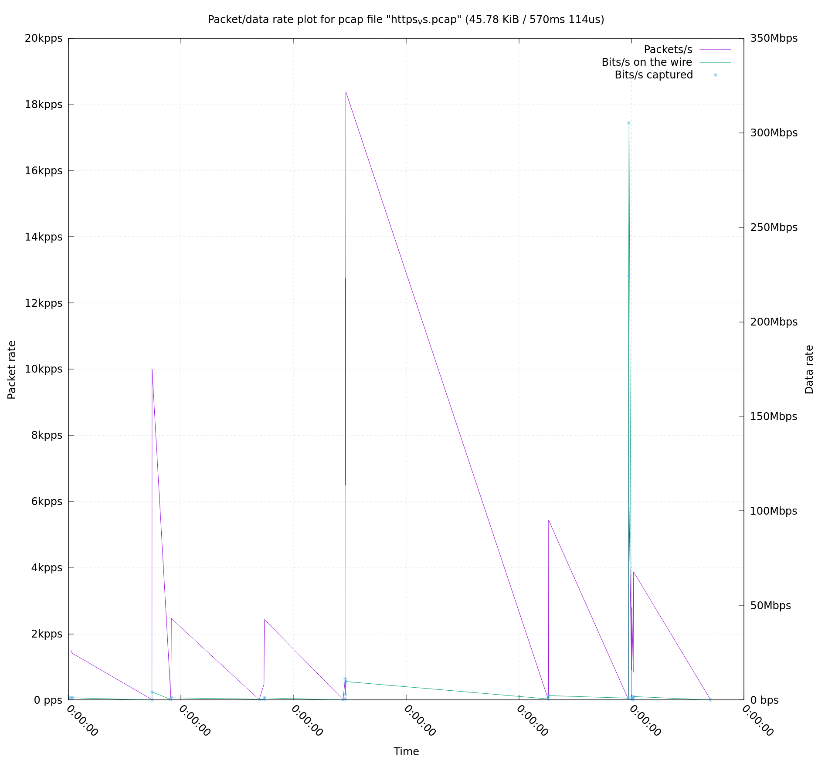
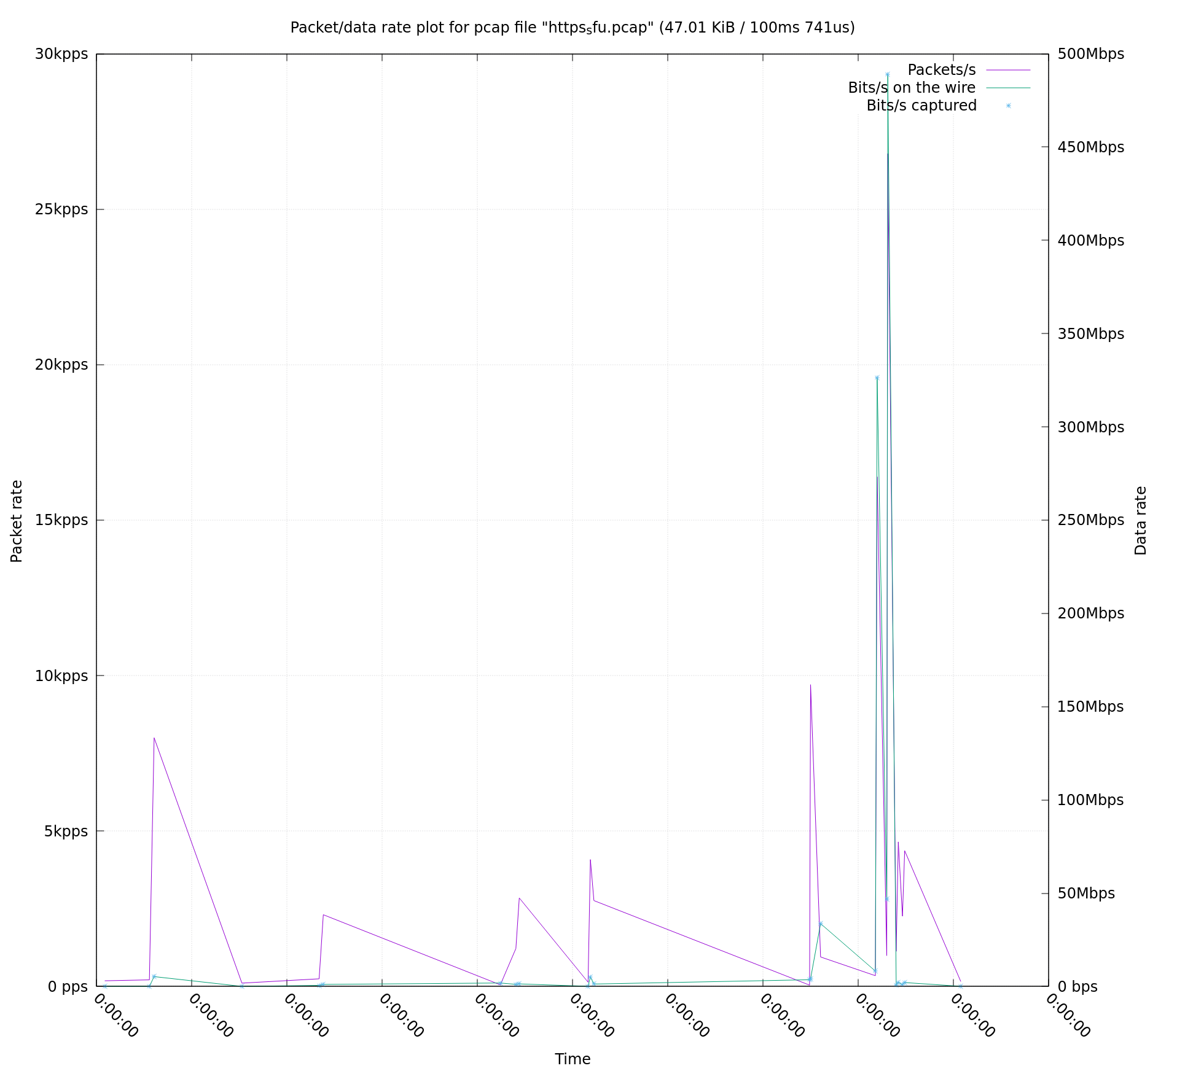
Simulation - The Results - TLS
https://www.httpvshttps.com
https://www.sfu.ca

Slide 11
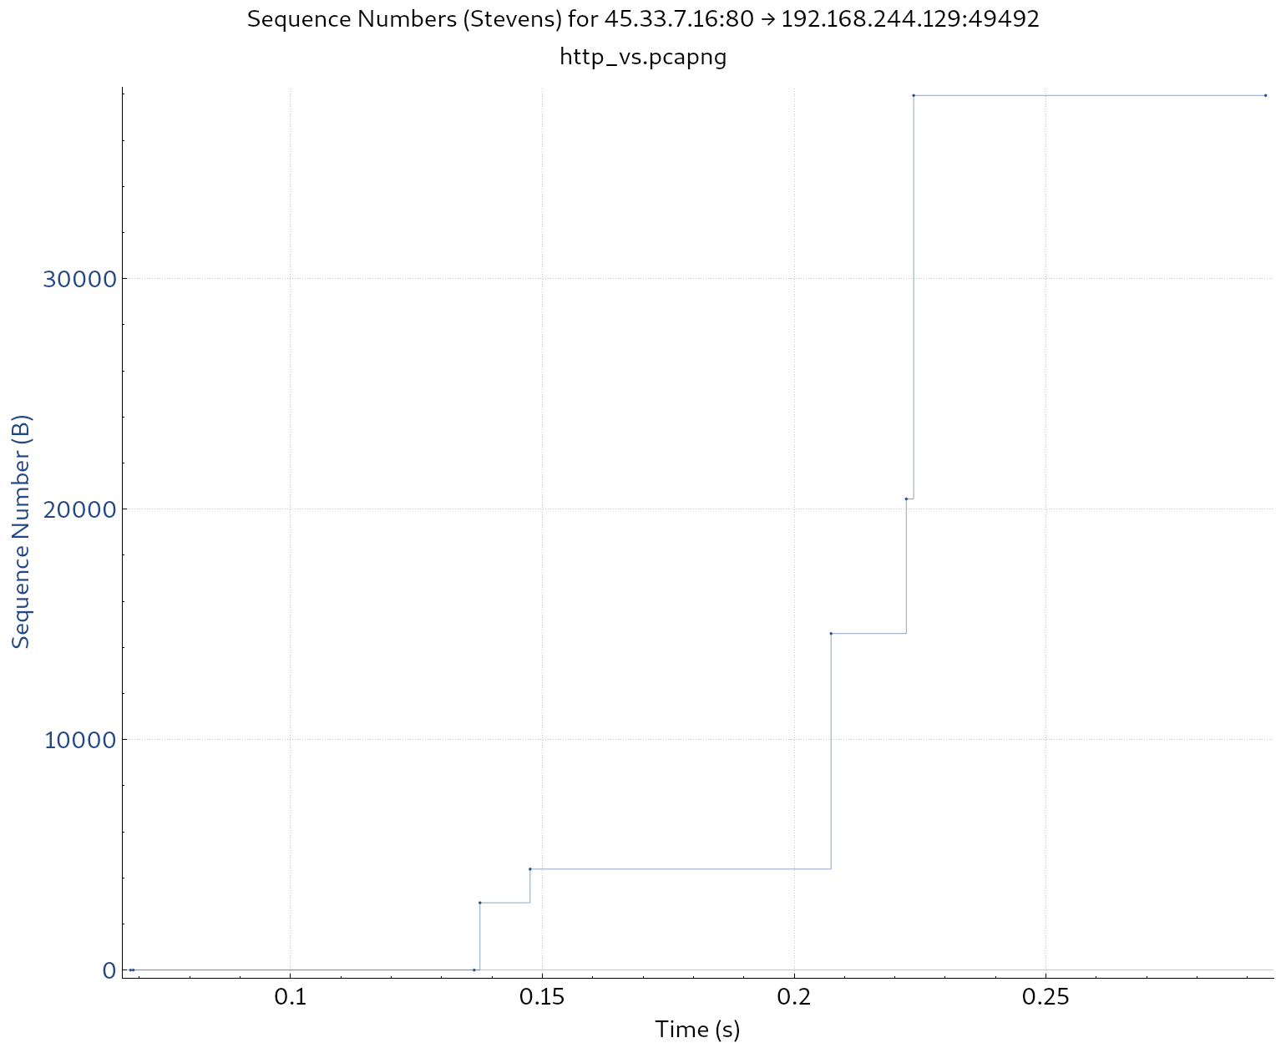
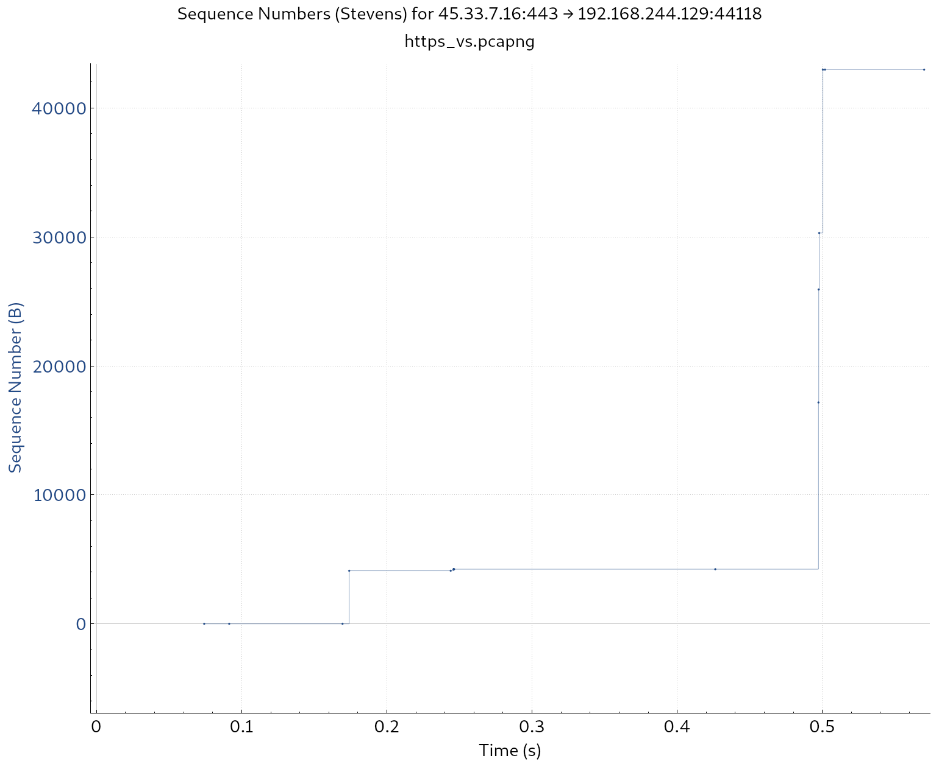
Simulation - The Results
http://www.httpvshttps.com
https://www.httpvshttps.com

Slide 12
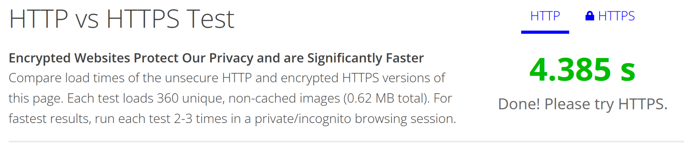
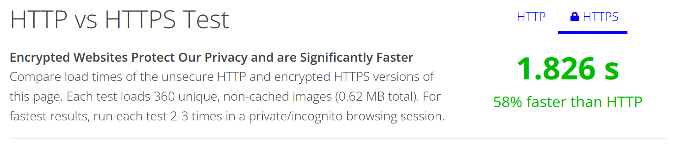
Discussion of Results
HTTP is faster than the encryption method of HTTPS.
However, TLS will protect the data you’re sending and receiving.
Additionally, the use of protocols such as SPDY and the development of HTTP/2 means most HTTPS websites can now mean perform faster than HTTP.

Slide 13
Future Works

Slide 14
Trusted Cloud Transfer Protocol (TCTP)
TCTP
Entity-body encryption technique
Fully HTTP compliant
Authenticates HTTP using TLS at application layer
Wrap TLS handshake protocol into HTTP payload
Reduces intermediary data leak risk
[10] Thomas, M. (2021, January 17). HTTPS vs SSL vs TLS. Medium.

Slide 15
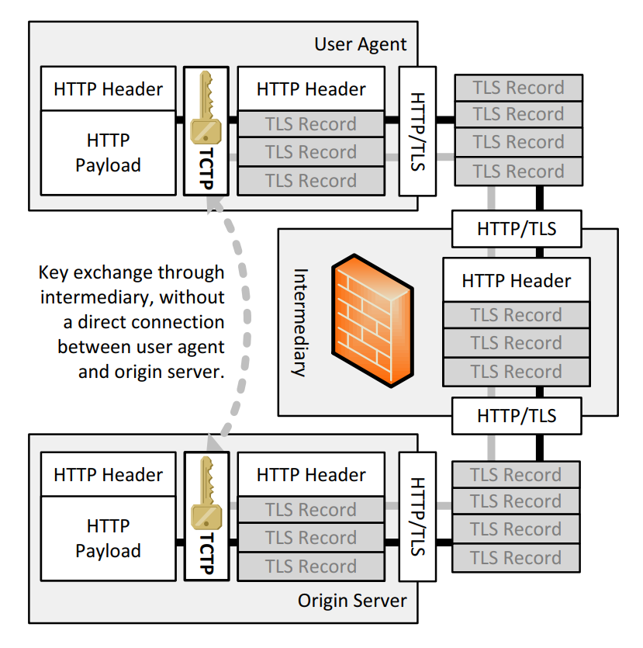
Trusted Cloud Transfer Protocol (TCTP)
Very similar to IPv4 using IPv6 as its payload to be compatible with both platforms.
Using the TLS method of encryption, the HTTP data will be encoded and sent as a HTTPS datagram.
At the application level, the datagram will be decoded back into its HTTP format.
This method of TCTP will enable site to be cross-compatible on both platforms.
[1] M. Slawik, "The Trusted Cloud Transfer Protocol,"

Slide 16
Thanks

Slide 17
Work Split
Riku
Idea formation
Introduction
Conclusion
Results interpretation
Alon
Literature review
Simulation design

Slide 18
References
[1] M. Slawik, "The Trusted Cloud Transfer Protocol," 2013 IEEE 5th International Conference on Cloud Computing Technology and Science, Bristol, UK, 2013, pp. 203-208, doi: 10.1109/CloudCom.2013.126. [Accessed: 26-Feb-2023]
[2] S. Müller, D. Bermbach, S. Tai and F. Pallas, "Benchmarking the Performance Impact of Transport Layer Security in Cloud Database Systems," 2014 IEEE International Conference on Cloud Engineering, Boston, MA, USA, 2014, pp. 27-36, doi: 10.1109/IC2E.2014.48. [Accessed: 26-Feb-2023]
[3] M. Msahli, M. T. Hammi and A. Serhrouchni, "Safe box cloud authentication using TLS extension," 2015 International Conference on Cyber Security of Smart Cities, Industrial Control System and Communications (SSIC), Shanghai, China, 2015, pp. 1-6, doi: 10.1109/SSIC.2015.7245679. [Accessed: 26-Feb-2023]
[4] Jabir, Raja & Khanji, Salam & Ahmad, Liza & Alfandi, Omar & Said, Huwida. (2016). Analysis of cloud computing attacks and countermeasures. 1-1. 10.1109/ICACT.2016.7423295. [Accessed: 26-Feb-2023]
[5] Singh, I. D. (2013, December). Data Security in cloud oriented application using SSL/TLS protocol - IJAIEM. Data Security in Cloud Oriented Application Using SSL/TLS Protocol. Retrieved February 27, 2023, from https://ijaiem.org/volume2issue12/IJAIEM-2013-12-10-022.pdf [Accessed: 26-Feb-2023]
[6] Corelight. (n.d.). Corelight/plotcap: Plot packet and data rates over time given a PCAP file, with gnuplot. GitHub. Retrieved April 11, 2023, from https://github.com/corelight/plotcap
[7] HTTP vs HTTPS TEST. HTTP vs HTTPS - Test them both yourself. (n.d.). Retrieved April 11, 2023, from http://www.httpvshttps.com/
[8] National Archives and Records Administration. (n.d.). The bill of rights: A transcription. National Archives and Records Administration. Retrieved April 11, 2023, from https://www.archives.gov/founding-docs/bill-of-rights-transcript
[9] Simon Fraser University. (n.d.). Retrieved April 11, 2023, from https://www.sfu.ca/
[10] Thomas, M. (2021, January 17). HTTPS vs SSL vs TLS. Medium. Retrieved April 11, 2023, from https://medium.com/plain-and-simple/https-vs-ssl-vs-tls-8a0ad0604276
[11] J. F. Kurose and K. W. Ross, Computer networking: A top-down approach. Harlow: Pearson Education Limited, 2022.

